Slide 1
GOWTHAM KUMAR R
Final Project
3/21/2024 Annual Review

Slide 2
PROJECT TITLE
Iris Flowers Classification (Decision Tree Algorithm)
3/21/2024 Annual Review

Slide 3


AGENDA
Introduction to Decision Tree Classifier
Problem Statement
Project Overview
End Users
Solution and its Value Proposition
Key Features
Modelling
Results and Evaluation
3/21/2024 Annual Review

Slide 4

PROBLEM STATEMENT
The problem involves classifying iris flowers into three species (Setosa, Versicolor, and Virginica) based on four features:
sepal length
sepal width
petal length
petal width
The goal is to build a classification model that accurately predicts the species of iris flowers given these features.
3/21/2024 Annual Review

Slide 5

PROJECT OVERVIEW
The project implements a Decision Tree Classifier to classify iris flowers based on their features. The Decision Tree algorithm recursively partitions the feature space into regions, making decisions based on feature values to classify the data.
3/21/2024 Annual Review

Slide 6

WHO ARE THE END USERS?
Botanists and researchers studying iris species
Agricultural professionals for plant species identification
Students learning about classification algorithms
Data scientists and analysts for educational or experimental purposes
3/21/2024 Annual Review

Slide 7

YOUR SOLUTION AND ITS VALUE PROPOSITION
Our solution provides a simple yet effective way to classify iris flowers based on their features. The value proposition includes:
Accurate classification of iris species
Interpretability of the decision-making process
Ease of use and implementation
Educational value for understanding classification algorithms
3/21/2024 Annual Review

Slide 8

THE WOW IN YOUR SOLUTION
Visualization of decision tree structure for intuitive understanding
Feature importance analysis to identify key predictors
Ability to handle both numerical and categorical features
Easily customizable parameters for model tuning
3/21/2024 Annual Review
8

Slide 9
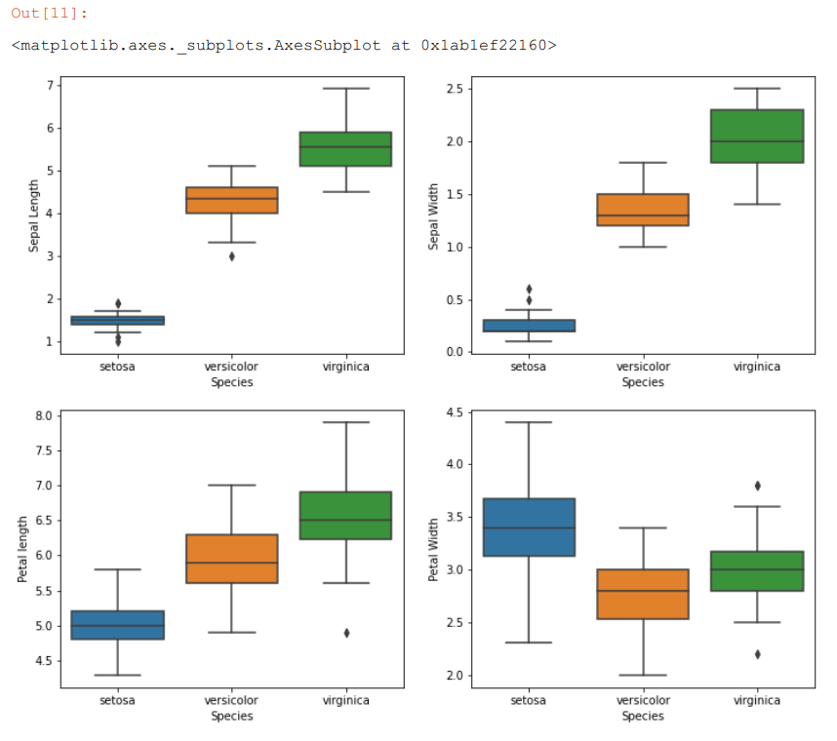
MODELLING
3/21/2024 Annual Review
9

Slide 10
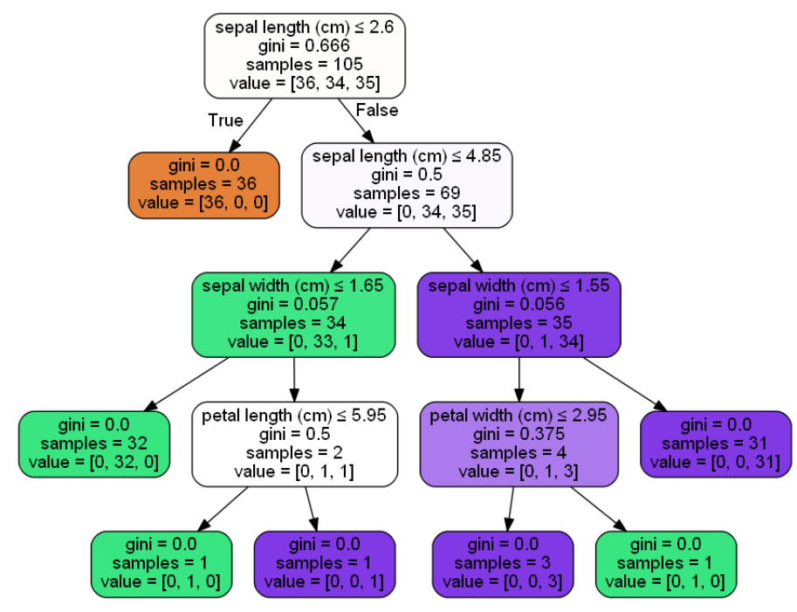
RESULTS
Evaluation Metrics: Accuracy, precision, recall, and F1-score
Visualizations: Confusion matrix, ROC curve (if applicable), and decision tree visualization Comparison with Baselines: Benchmarking against other classification algorithms or models Interpretation: Analyzing feature importance and decision rules for insights into the classification process
Demo Link
3/21/2024 Annual Review
10

